Slide 1
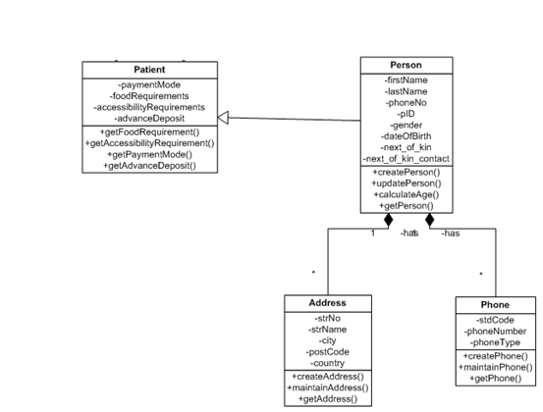
Class Diagram Patient Package

Slide 2
